Slide 1
Quantitative PET Imaging;
from Research to Clinical Use
Fiona Heeman
22 & 23 October 2018 • IMI Scientific Symposium • Brussels, Belgium

Slide 2

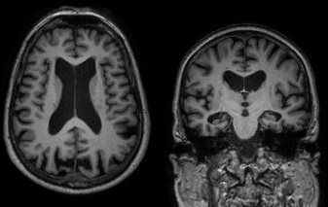
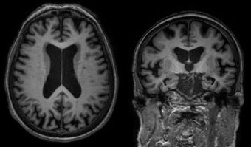
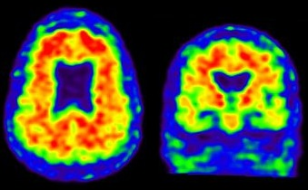
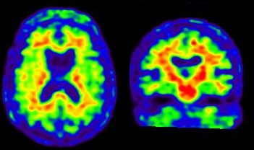


AMYPAD
Amyloid Imaging to prevent Alzheimer’s Disease
Patient A
Patient B
Patient A
Patient B
Methodology
Diagnostic study | Prognostic study
8 centers | Up to 20 centers
1200 scans | 3000 scans
Assess diagnostic value Aβ | Risk stratification
Usefulness Aβ imaging in patient management | Secondary prevention studies
Notes:
MR scans of two early stage alzheimer patients it is hard to see any structural differences between them.
On the other hand, an amyloid PET scan: allows for detection of changes very early in the disease. Here it is clear that Patient A has a lot of amyloid depositions in the GM, in contrast to patient B.
Within Amypad, we are interested in this Amyloid beta protein. Because the accumulates of Abeta in the brain is the first hallmark of Alzheimer’s Disease
Within 2 studies:
Diagnostic study: diagnostic value, patient management, 8 centers - 900subj → 1200scans
Prognostic study: secondary prevention studies, risk stratification, up to 20 centers (epad and amypad) -2000sub 3000scans
The total of 4200 scans within project are possible due to the collaboration with large pharmaceutical companies, with tracer delivery all over Europe, centers all over Europe can be involved. Hence, we can reach the amount of scans, which will lead to a high power to detect changes.

Slide 3
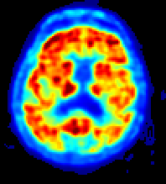
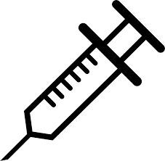
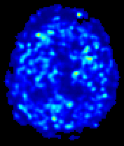
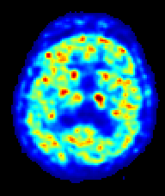
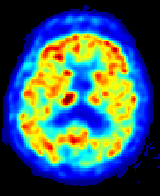
Rationale
PET allows for visualization& quantification of amyloid-β in the brain
Static
Diagnostic use
Positive/negative amyloid scan
Indirect measure of amyloid load
0 min
90min
110 min
Coffee-break protocol
Dynamic
Longitudinal measurements
-Treatment response/ disease progression
- Direct measure of amyloid load
0 min
x min
90 min
110 min
Notes:
For visualization and quantification purposes, two different kinds of scans are used
0 min = PET radioactive tracer injected
Explain advantages and disadvantages of static and of dynamic scan
90-110 = Static scan acquired → Short, useful for positive/negative classification [indirect measure of amyloid load, biased by other factors..)]
0-110 = Dynamic scan acquired → Long, burdensome to patient, especially AD patient (difficult to lay still for so long) , less efficient scanner and tracer batch use.
→ Goal to have the agreed number of scans within the agreed tracer batch production, and high quality data for longitudinal analysis.
Therefore, introduction of a protocol in which the patient is scanned immediately after tracer injection and during the late static interval. = break in between for resting. Trade off between accuracy and scanning time. Enables us to scan enough patients from one batch.

Slide 4
Data & Methods
Clinical data: AD & control subjects for both amyloid PET tracers
Tracer kinetics simulated based upon clinical data
Simulated data covered the whole disease spectrum
Assessment of the bias in amyloid load quantification
Different scanning protocols were deleted
Represented various noise levels
Notes:
The project was possible because of the clinical PET data provided by GE and Piramal of the two amyloid tracers used in AMYPAD.
Discuss steps.
Many oppportunities to receive feedback from people with various backgrounds, industry and academia, clinicians, physisists etc.
Extra:
Concrete challenge of my research → based upon limited amounts of data, run simulations to understand the effect of a resting period in between the short scans on quantification of amyloid load.
- Different noise levels: regions of different sizes / other sources of noise: higher tracer injection

Slide 5
Conclusion
Optimal coffee-break scanning protocol: 0-30 minutes & 90-110 minutes
45 min
75 min
0 min
30 min
90 min
110 min
Patient comfort:
60 min rest
60 min
Direct comparison with static scans
Interleaved scanning
Accurate estimates of amyloid load
Efficient tracer batch& scanner time use
Notes:
30-90 most optimal for both amyloid PET tracers
Patients have one hour in between for resting
Enables interleaved scanning = efficient tracer batch and scanner usage. → within the contribution agreed with GE and Piramal.
Accurate estimates of amyloid load
Also direct comparison with static scans is possible, due to the inclusion of this window.

